Slide 1


HIT391 MACHINE LEARNING: ADVANCEMENTS AND APPLICATIONS
Lecturer:
Dr. Yan Zhang (Danana)
Dr. Al-Amoodi, Abdullah (Sydney)
Email:
yan.zhang@cdu.edu.au
abdullah.al-amoodi@cdu.edu.au

Slide 2
Examples of ML Applications

Slide 3
ML Applications
Why AlphaGo Won？
Rcommender System
Information Retrieval
Smart Monitoring and Tracking
Remote Sensing Satellite Image Recognition and Detection
Intelligent Recognition of Cultural Relics
Smart Healthcare
Smart Inspection
Risk Evaluation

Slide 4
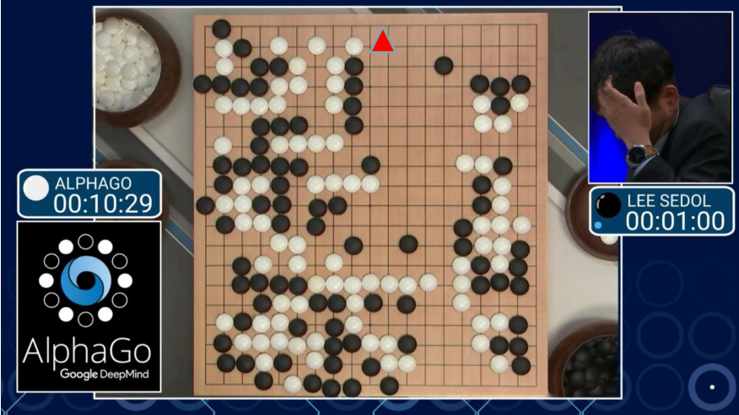
Why AlphaGo Won?
The 1st Strategy: Imitating experts.

Slide 5
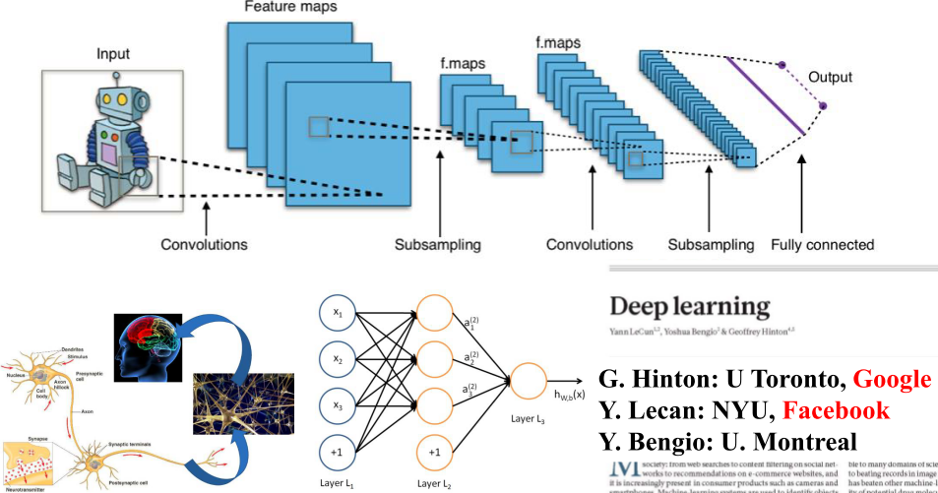
Why AlphaGo Won?
The 1st Strategy: Imitating experts - Deep Convolutional Neural Networks (DCNN).

Slide 6
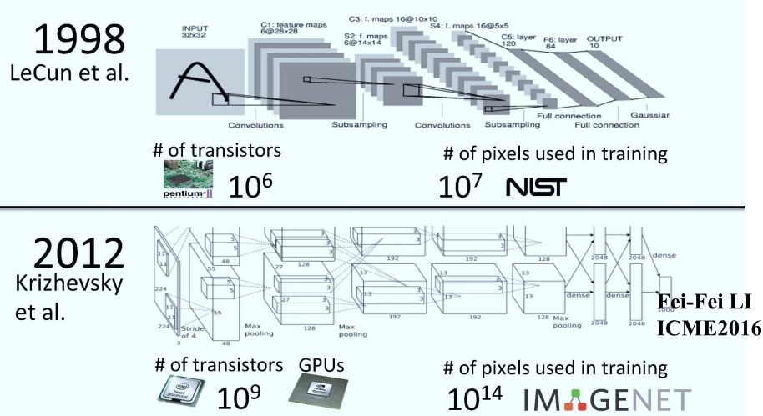
Why AlphaGo Won?
The 1st Strategy: Imitating experts - Deep Convolutional Neural Networks (DCNN).

Slide 7
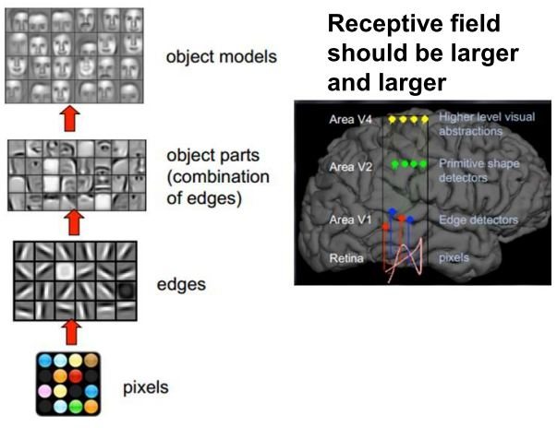
Why AlphaGo Won?
The 1st Strategy: Imitating experts - Deep Convolutional Neural Networks (DCNN).

Slide 8
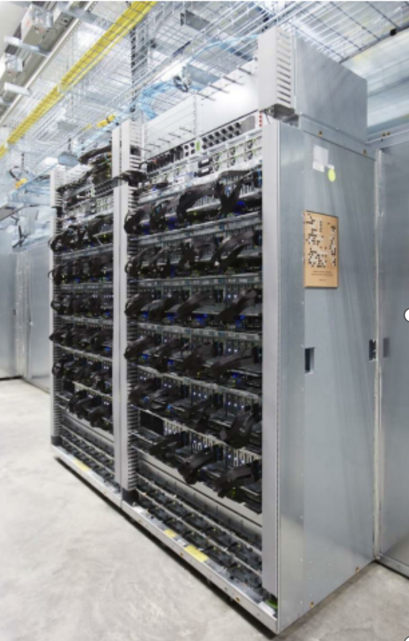
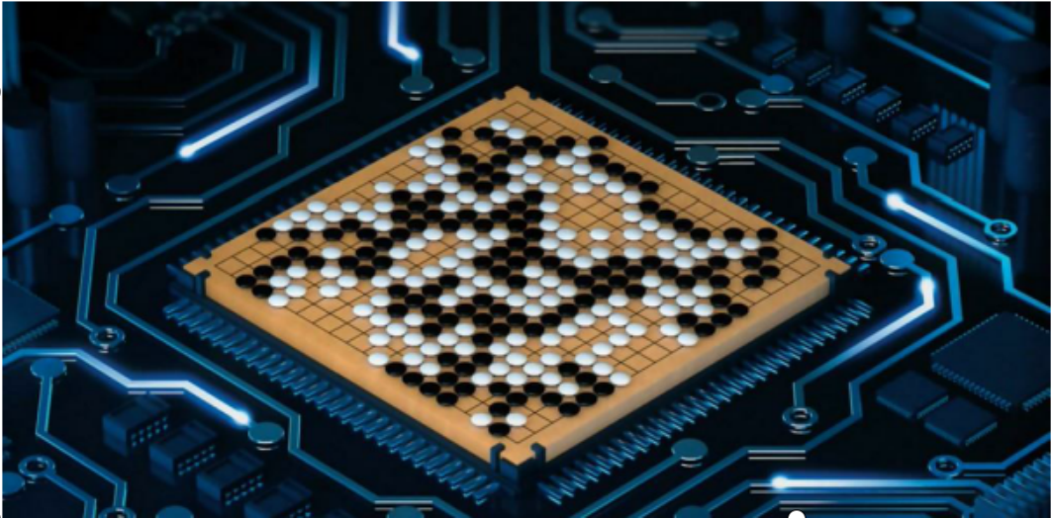
Why AlphaGo Won?
The 1st Strategy: Imitating experts - DCNN
Big data of game Go : 150,000 professional players, millions of amateurs.
Supercomputer: 1202 CPUs, 176 GPUs.

Slide 9

Why AlphaGo Won?
The 2st Strategy: Surpassing experts - Self-learning
Learn from self-play.

Slide 10
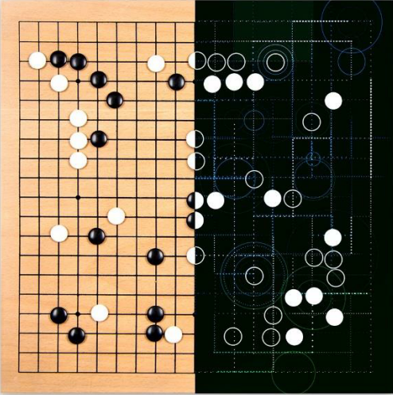

Why AlphaGo Won?
The 2st Strategy: Surpassing experts - Self-learning.
Self-play

Slide 11
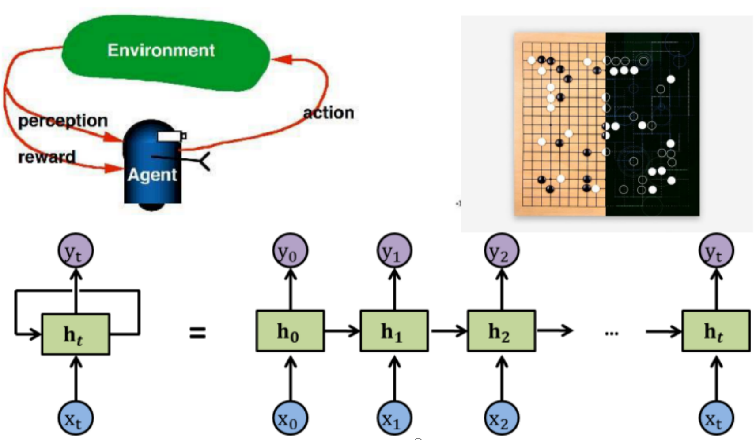
Why AlphaGo Won?
The 2st Strategy: Surpassing experts - Self-learning: Deep Reinforcement Learning (DRL)
Reinforcement Learning: Agents learn by interacting with the environment.
Deep Convolutional Neural Networks (DCNN)

Slide 12
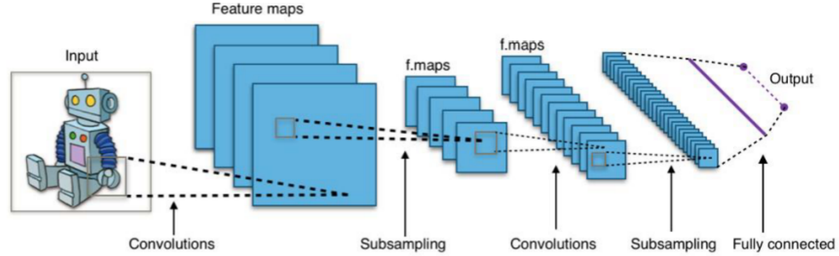
Why AlphaGo Won?
The 2st Strategy: Surpassing experts - Self-learning: Deep Reinforcement Learning (DRL)
Reinforcement Learning: Agents learn by interacting with the environment
Imitating experts
DCNN：
DRL：
Find a good move
Alternate sides play, self-evolution
Generate a massive number of games.
Surpassing experts

Slide 13
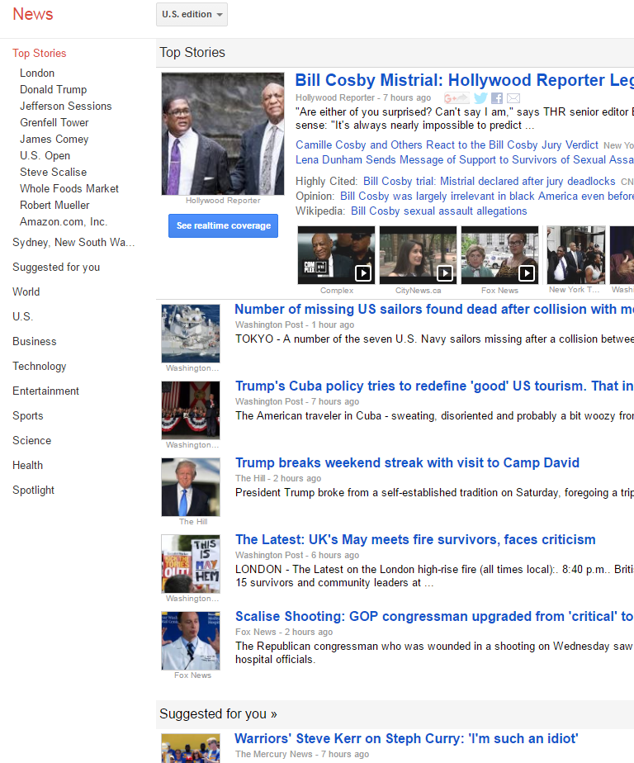

Recommender System
Recommender systems are now widely integrated into E-commerce websites and online news platforms. They play a crucial role in helping users discover items they might like or find interesting.
Google news recomemndation
Amazon recommendation

Slide 14
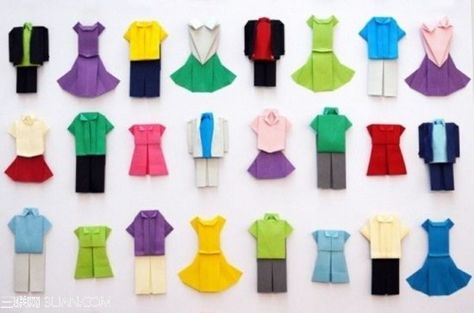

Recommender System
The nature of recommendation is similarity match, which contains two main steps: offline training, and online recommendation.
Offline training
Train the recommendation model (Clustering, KNN, Deep Learning, etc.) with known data.
Online recommendation
Extract users’ features from their historical behaviour data, etc.
Extract items’ features from items’ images, descriptions, etc.
Similarity search and recommend.
Extract features
Recommend
Model
Similarity search
A user
Historical data

Slide 15
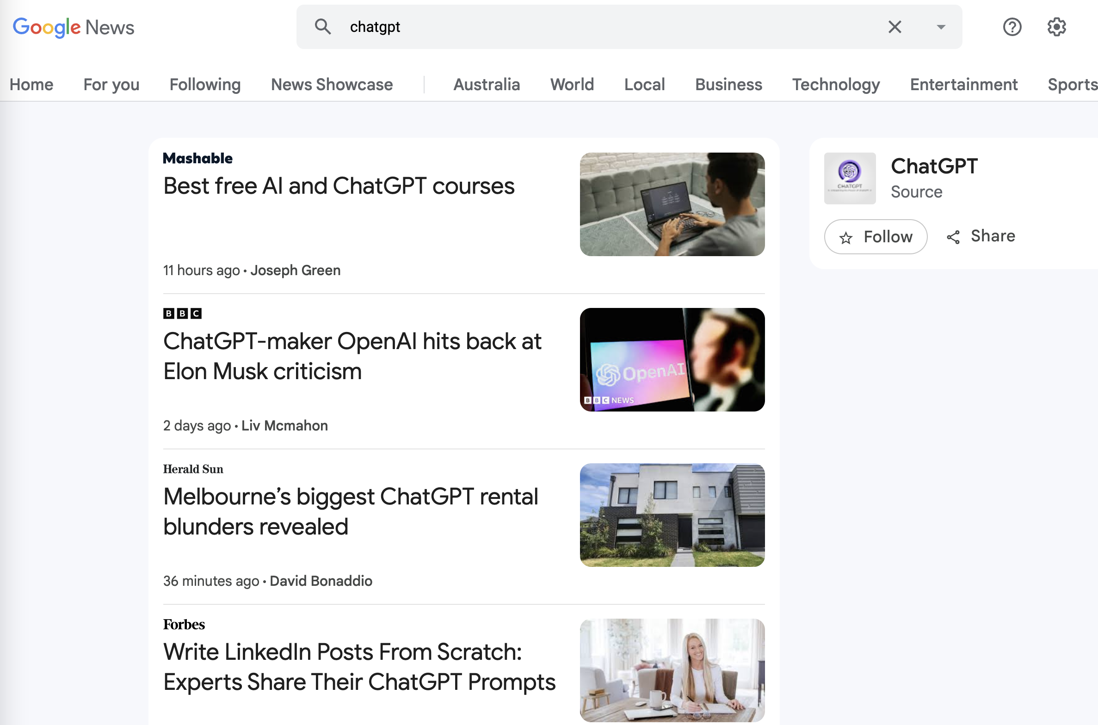
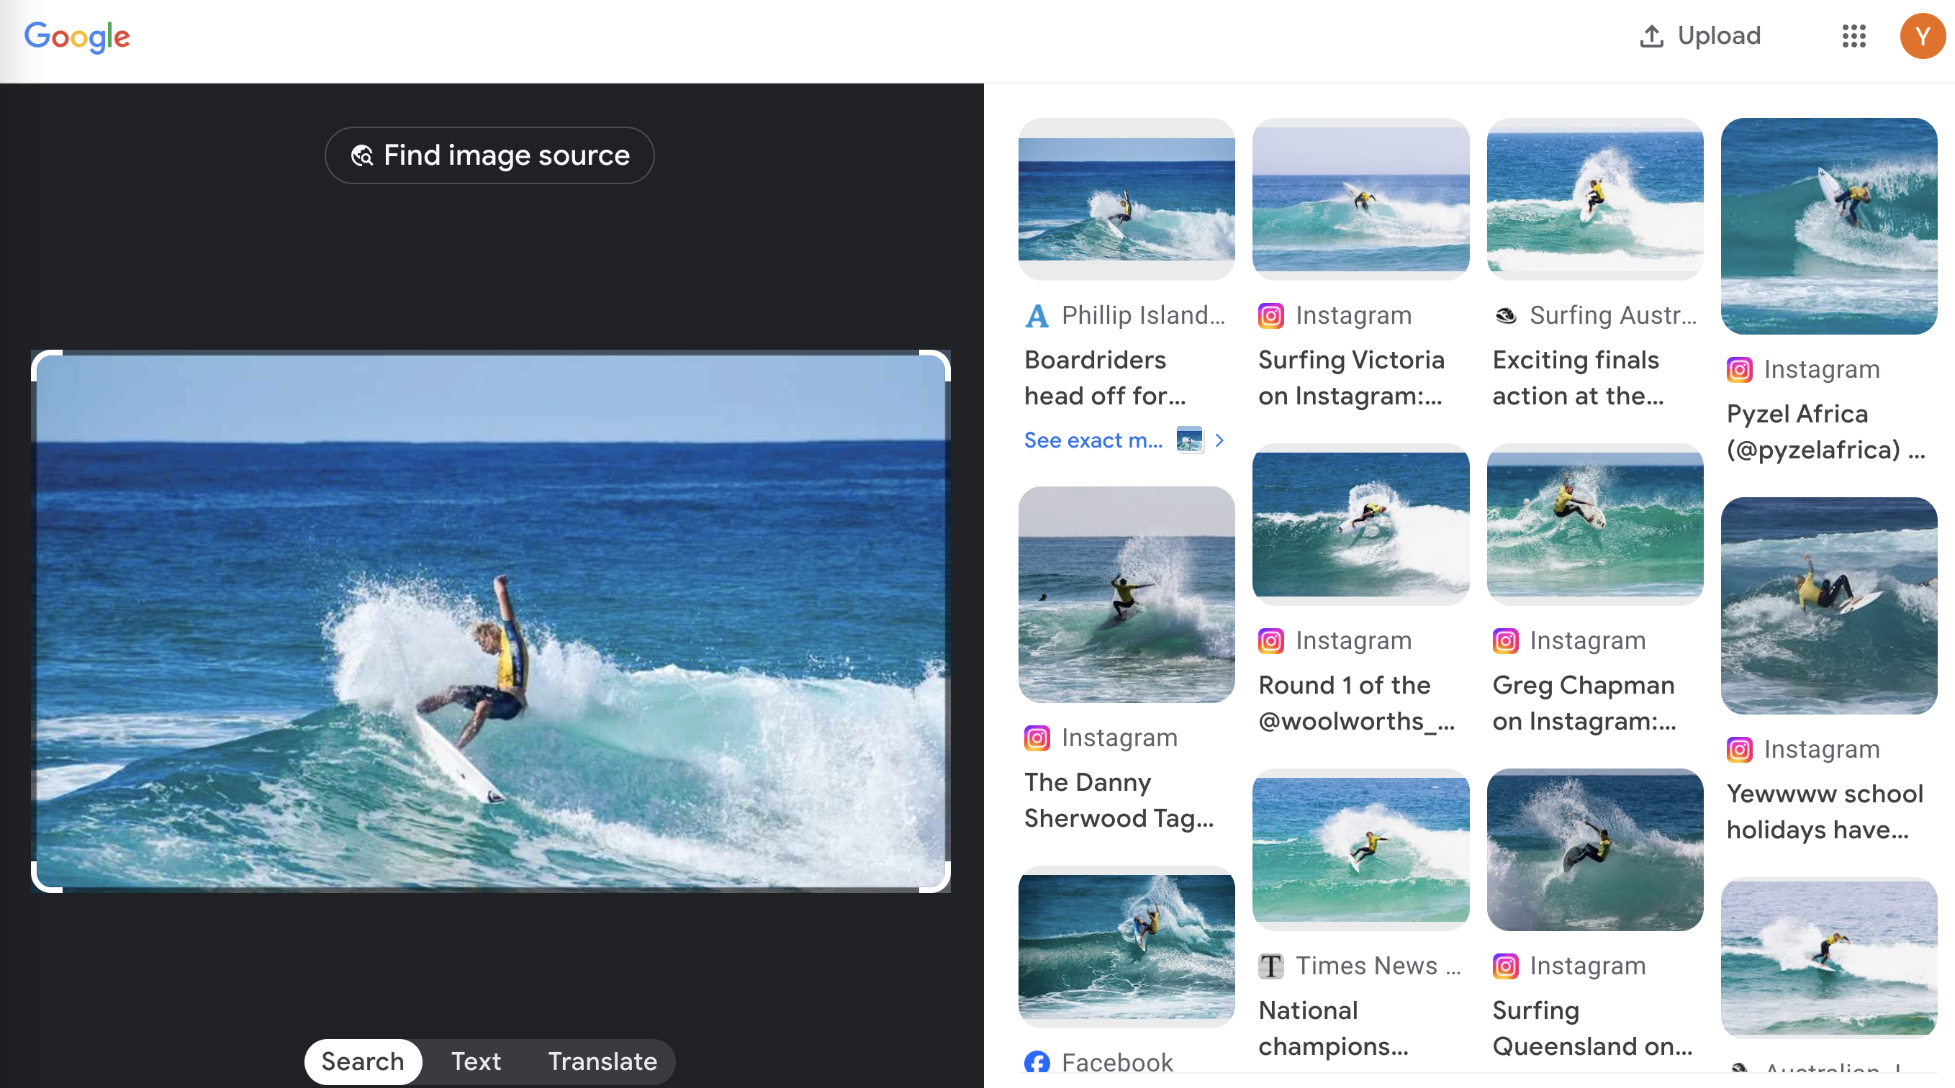
Information Retrieval
Multi-modal information retrieval system
Text-to-text / text-to-image; Image-to-image / image-to-text
Supervised Learning, Unsupervised Learning, etc.

Slide 16
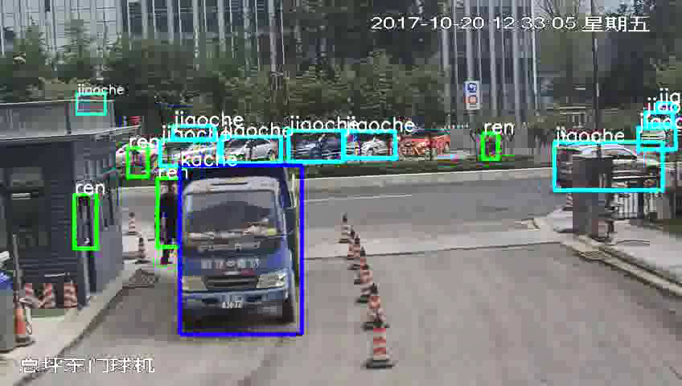
Smart monitoring and tracking
Deep learning to detect and classify various vehicles, such as cars, vans, trucks, etc.
traffic flow monitoring, detecting polluting vehicles, and identifying traffic accidents.

Slide 17
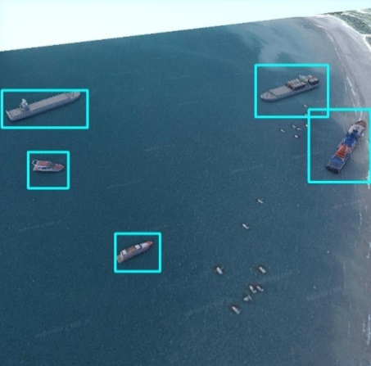
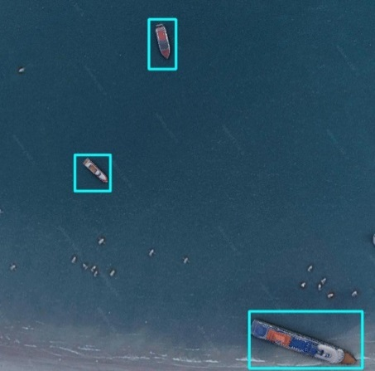
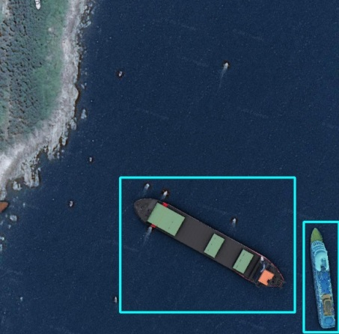
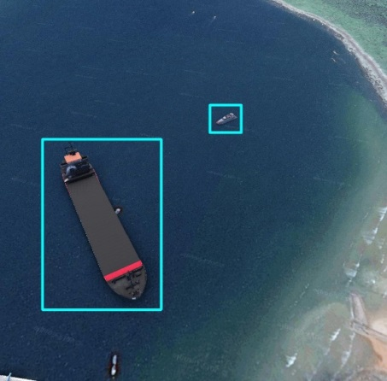
Remote sensing satellite image recognition and detection
Detection of ships at sea
Substantial risks inherent in maritime operations.
How to use satellite imaging technology and artificial intelligence for the efficient and swift identification of targets at sea is essential for humanity to maximize the utilization of the ocean's resources.

Slide 18
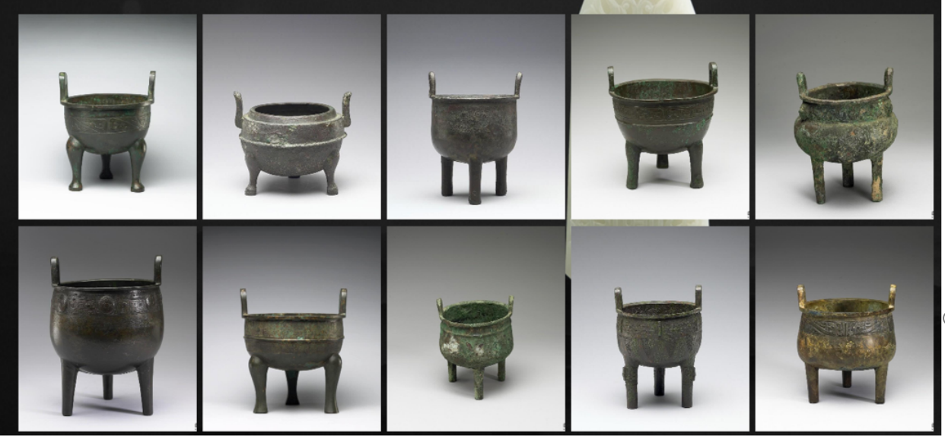
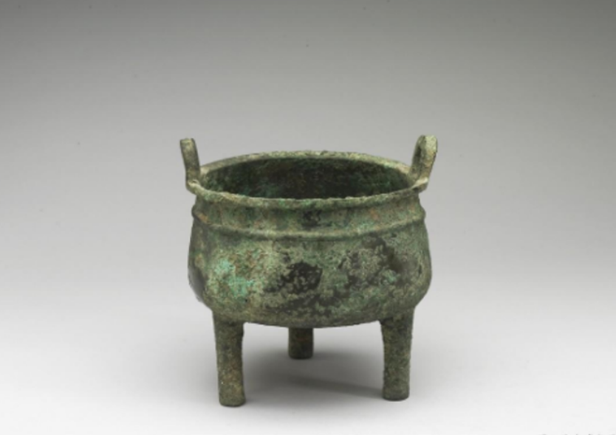
Intelligent recognition of cultural relics
Analysis and recognition of cultural relics
Automatically identify similar artifacts. (Unsupervised Learning)
2. Automatically identify the dynasty, type, and other attributes of cultural relics.
(Supervised Learning)
Category | Probablity | Dynasty | Probability
Bronze artifacts, metalware | 0.999 | 1046 BC - 771 BC | 0.998
ceramic artifacts | 0.000 | 1600 BC-1046 BC | 0.001

Slide 19
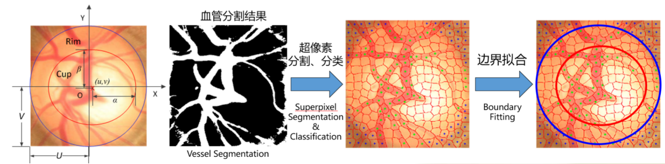
Smart healthcare
Automatic screening technology for glaucoma
(Supervised Learning / Unsupervised Learning, etc.)

Slide 20
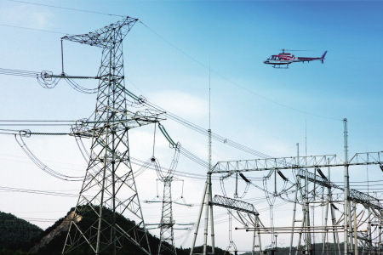
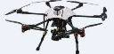
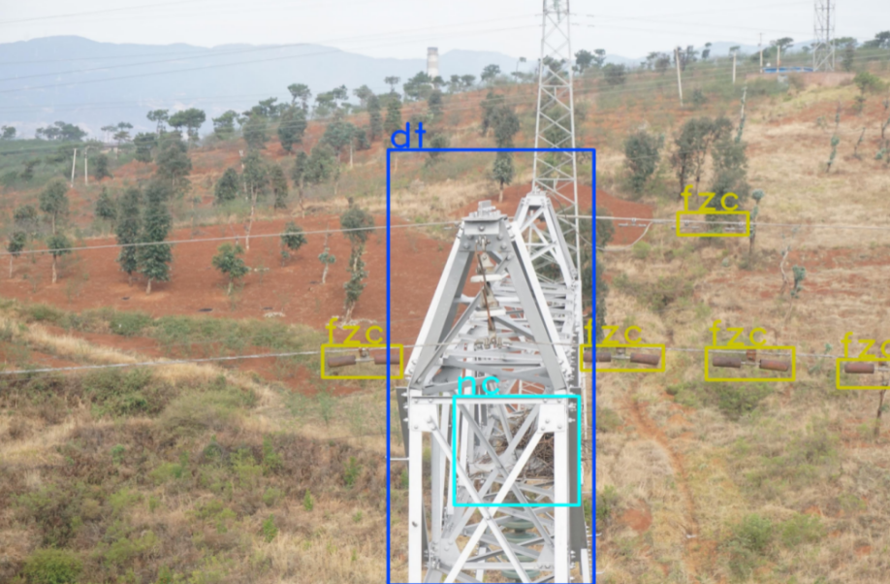
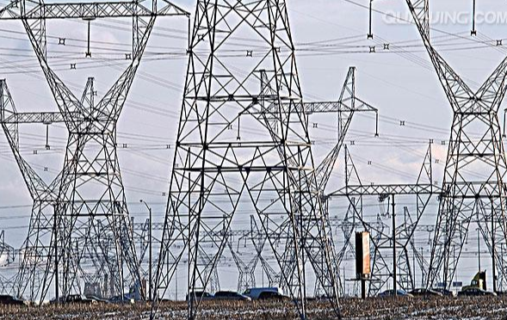
Smart Inspection
Tower Inspection: Automatic detection of key components of the tower and identification of potential issues in relevant areas (such as rust, detachment, etc.)

Slide 21
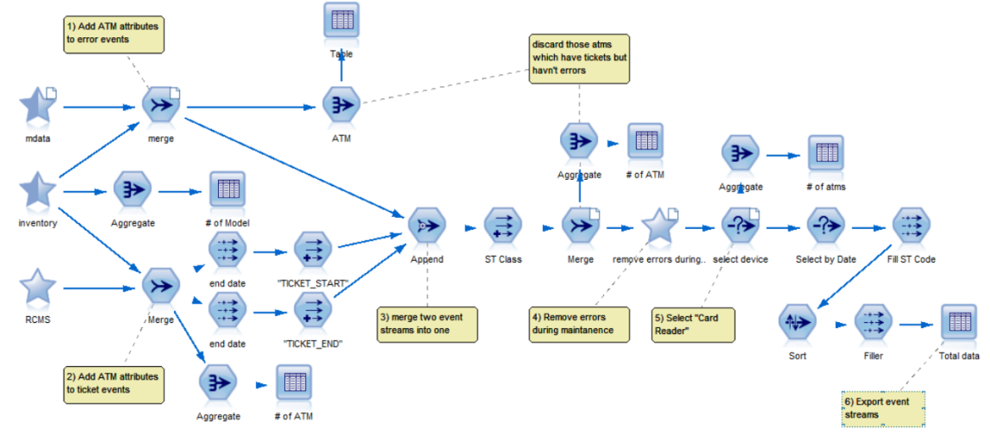
Risk Analysis Prediction
Risk Analysis Prediction for Business Closure
For small and medium-sized enterprises (SMEs), it is challenging for banks to objectively assess their financial and credit information, which is crucial for lending decisions. (Regression, etc.)

